Slide 1

Grocery Store Management

Slide 2
Introduction
The Grocery Management System is designed to streamline and automate the daily operations of grocery stores.
It provides an efficient way to manage inventory, sales, suppliers, and customers using a centralized database.
The project uses SQL as the backend to store, retrieve, and manage data securely and efficiently.
The system helps in tracking stock levels, updating product details, and generating billing and sales reports.
It reduces manual errors, improves data accuracy, and saves time and effort in managing store operations.
The project allows for easy addition, deletion, and modification of grocery items and related information.
It provides real-time access to product availability and pricing details.
The system enhances decision-making through data-driven insights such as sales trends and inventory analysis.
This project demonstrates the practical use of SQL queries, relationships, and normalization in database design.
Overall, the Grocery Management System aims to create a user-friendly and reliable database solution for managing grocery store activities efficiently.

Slide 3

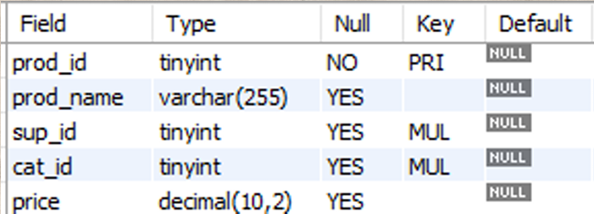
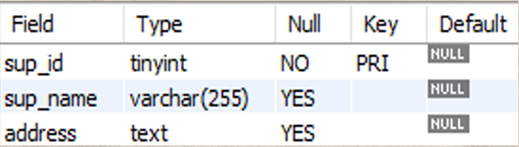
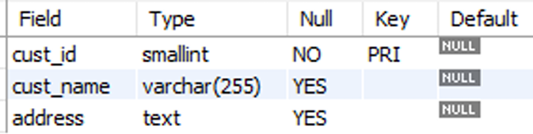
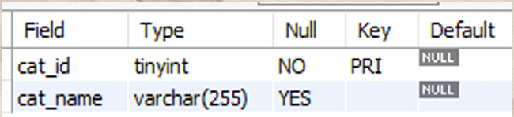
Tables
Products Table
Suppliers Table
Customers Table
Categories Table

Slide 4
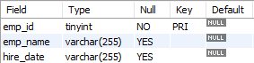
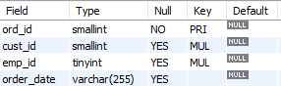
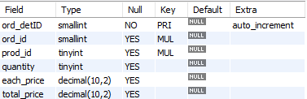
Tables
Employees Table
Orders Table
Order_details Table

Slide 5
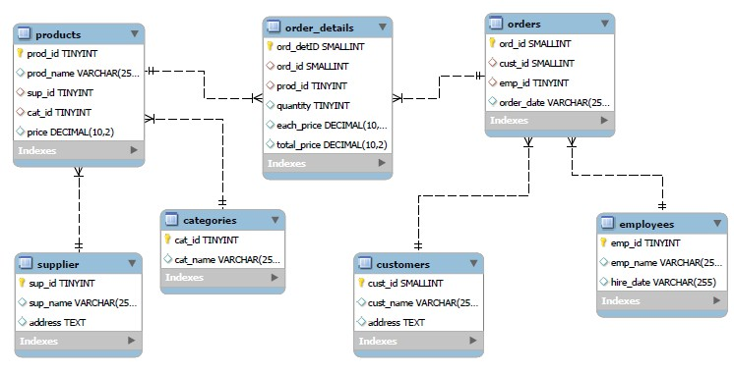
ER Diagram

Slide 6
Problem Statement
In today’s competitive retail environment, grocery stores generate vast amounts of data concerning products, suppliers, customers, and transactions. Efficiently managing and analyzing this information is essential for smooth operations and data-driven decision-making. This project focuses on developing a relational database system that effectively records and organizes key store activities while allowing users to perform advanced data analysis through SQL. The system is designed to handle complex queries for uncovering valuable business insights — such as identifying best-selling products, loyal customers, and sales trends — while strengthening practical SQL skills, including joins, aggregations, subqueries, and data filtering.

Slide 7

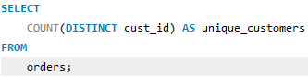
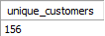
1.How many unique customers have placed orders?

Slide 8
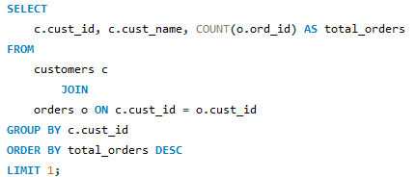
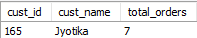
2.Which customers have placed the highest number of orders?

Slide 9
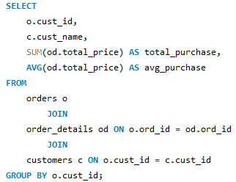
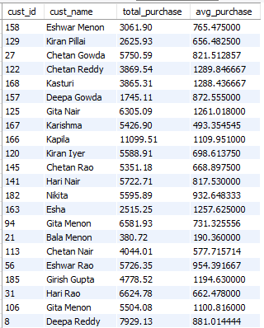
3.What is the total and average purchase value per customer?

Slide 10
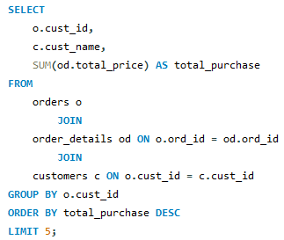
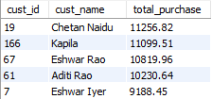
4.Who are the top 5 customers by total purchase amount?

Slide 11
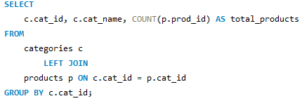
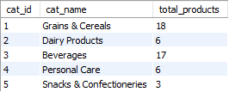
5.How many products exist in each category?

Slide 12
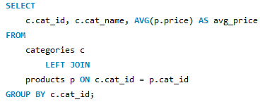
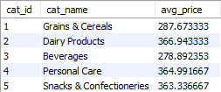
6.What is the average price of products by category?

Slide 13
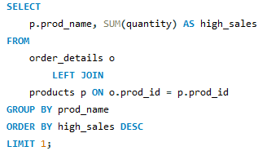
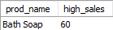
7.Which products have the highest total sales volume (by quantity)?

Slide 14
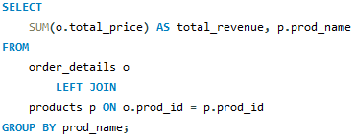
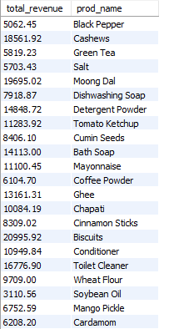
8.What is the total revenue generated by each product?

Slide 15
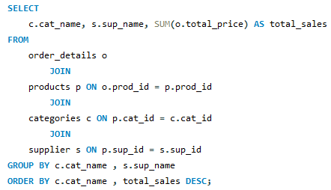
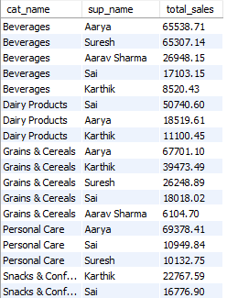
9.How do product sales vary by category and supplier?

Slide 16
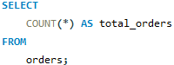
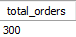


10.How many orders have been placed in total?

Slide 17
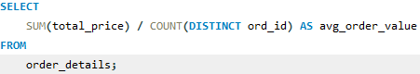
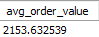
11.What is the average value per order?

Slide 18
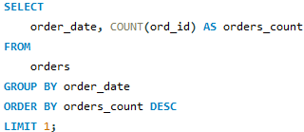
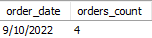
12.On which dates were the most orders placed?

Slide 19
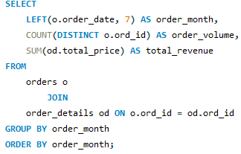
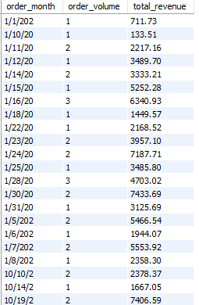
13.What are the monthly trends in order volume and revenue?

Slide 20
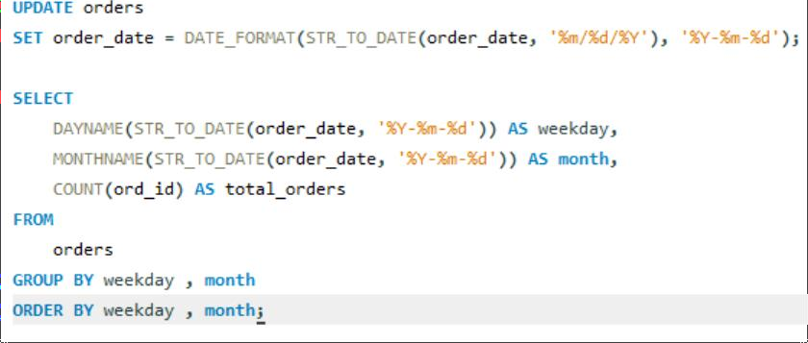
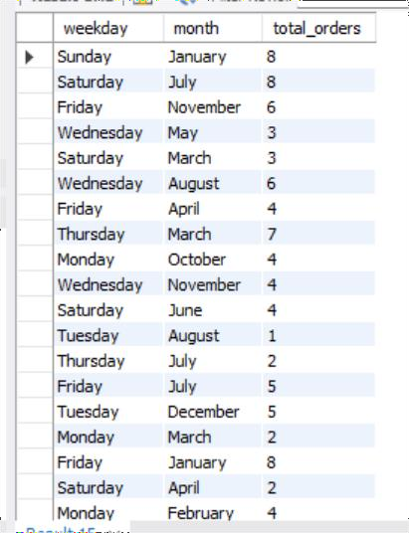
14.How do order patterns vary across weekdays and months?

Slide 21
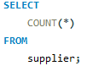
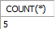
15.How many suppliers are there in the database?

Slide 22
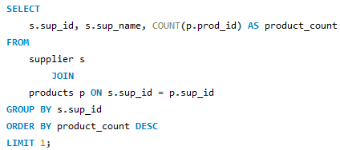
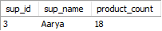
16.Which supplier provides the most products?

Slide 23
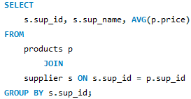
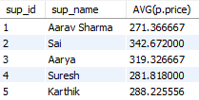
17.What is the average price of products from each supplier?

Slide 24
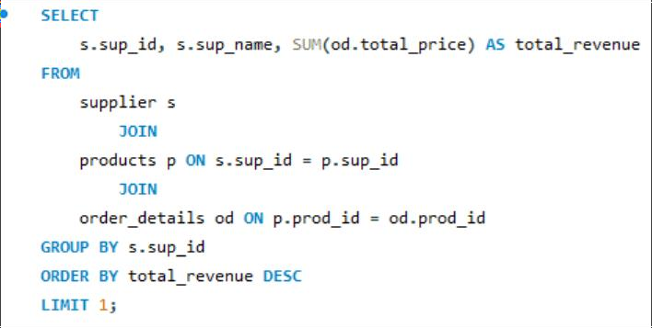
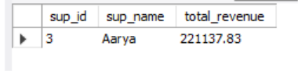
18.Which suppliers contribute the most to total product sales (by revenue)

Slide 25

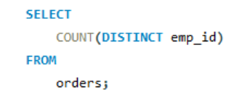
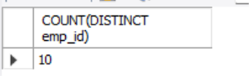
19.How many employees have processed orders?

Slide 26

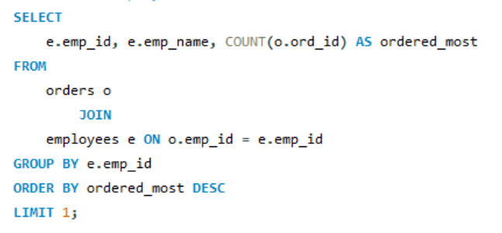
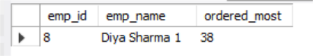
20.Which employees have handled the most orders?

Slide 27
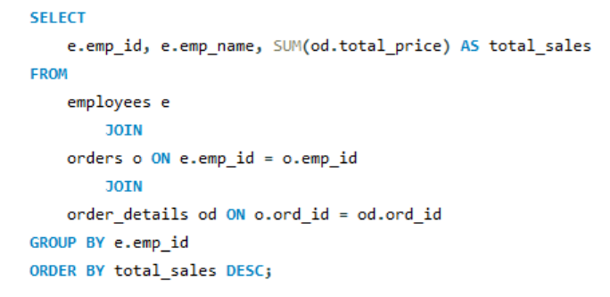
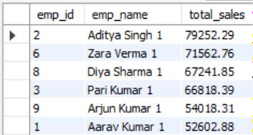
21.What is the total sales value processed by each employee?

Slide 28


22.What is the average order value handled per employee?

Slide 29


23.What is the relationship between quantity ordered and total price?

Slide 30


24.What is the average quantity ordered per product?

Slide 31


25.How does the unit price vary across products and orders?

Slide 32






Thank You for your attention
Group Members:
Atish Mohapatra Raju Partham Yaswanth G V N S

